Slide 1
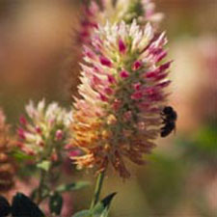
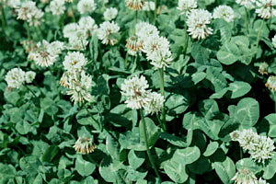
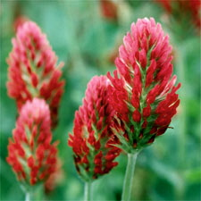
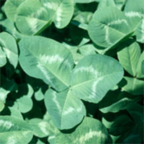
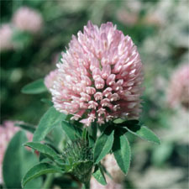
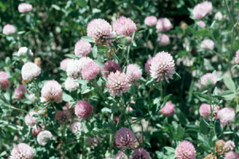
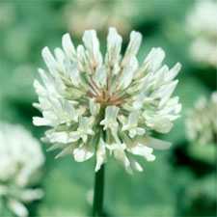
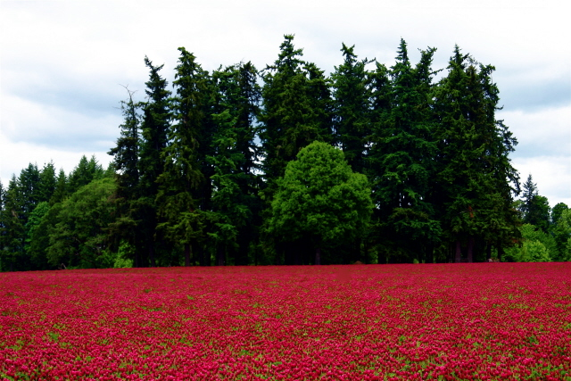
Ten Great Reasons for Growing Clover
Notes:
Clovers have long been viewed as being unique and beneficial plants, but incentives for using them have increased.

Slide 2
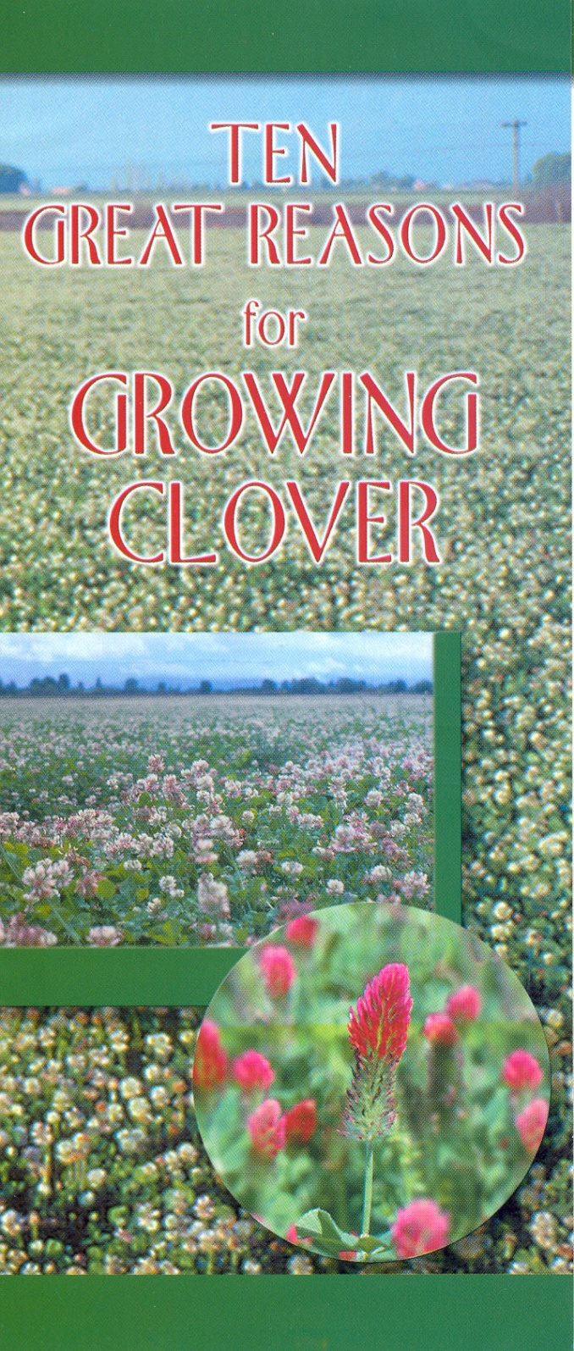
Notes:
Ten Great Reasons for Growing Clovers, an Oregon Clover Commission publication, explains benefits clovers offer. These benefits vary in importance depending on the situation.

Slide 3
Biological Nitrogen Fixation
Improved Forage Quality
Better Distribution of Growth
Increased Forage Yield
Reduced Risk
Benefits in Crop Rotation
Reduced Animal Toxicities
Environmental Acceptability
More Interesting and Attractive Pastures
Increased Profit
Notes:
Improved yield and quality, better distribution of growth and nitrogen fixation are of particular importance to forage/livestock producers.

Slide 4
Biological
Nitrogen
Fixation
Notes:
Rhizobium bacteria associated with clover roots obtain nitrogen from the atmosphere and “fix” it in nodules on the roots. The amount of nitrogen fixed varies depending on species, stand density, fertility, weather and the extent to which the clover has been defoliated.

Slide 5
Nitrogen Fixation
40 to more than 200 pounds / acre / year
Notes:
Considerable variation exists among species. Nitrogen fixation can range from 40 to over 200 lbs/acre/yr.

Slide 6
Value and Amount of Nitrogen Fixed by Various Clovers
Crop | N fixed, Lb/A/yr | N value
 |  | 45¢/lb | 55¢/lb | 65¢/lb | 75¢/lb
Red clover | 75-200 | 34-90 | 41-110 | 49-130 | 56-150
White clover | 75-150 | 34-68 | 41-83 | 49-98 | 56-113
Crimson, Arrowleaf and other annual clovers | 50-150 | 23-68 | 28-83 | 33-98 | 38-150
SOURCE: Adapted from Southern Forages 2007
Notes:
Nitrogen fixation can be worth $20 to over $100 per acre per year.

Slide 7
Improved Forage Quality
Notes:
It has long been recognized that the forage quality of legumes, including clovers, is generally higher than that of most forage grasses. Legumes are usually higher in crude protein, digestibility, and many minerals and vitamins, and are digested more rapidly than grasses. The result is better animal performance.

Slide 8
Forage Quality Difference
Forage | Crude Protein | Digestibility | Time in Rumen
 | -------------%------------ |  | hours
Grasses | 15.3 | 55 | 90
Legumes | 19.3 | 62 | 36
Source: University of Kentucky
Notes:
Forage quality varies considerably due to many factors, especially species and stage of maturity.

Slide 9
Clover Increases Gain
Pasture | Daily Gain Lb/steer | Total Gain Lb/steer | Total Gain Lb/A
Fescue + Ladino | 1.53 | 307 | 582
Fescue + Nitrogen* | 1.06 | 203 | 374
*150 lbs/N/ac/yr Source: Hoveland, et.al., Bull. #500, Alabama.
Notes:
Clovers provide higher forage quality, which results in improved animal performance.

Slide 10
Improved Distribution of Growth
Notes:
The introduction of clovers into grass pastures often extends the grazing season as compared to grass alone. Red clover is especially likely to provide additional summer production when grown with cool season perennial grasses. Addition of cool season annual clovers to bermudagrass or other warm season perennial grasses permits production of quality feed during winter and early spring when pastures would otherwise be less productive.

Slide 11
Y
I
E
L
D
SUMMER
SLUMP
MAR
AUG
FEB
MONTH
Cool season grasses Do Not produce as well during
hot, dry months of summer. Deep-rooted clovers like red clover can improve summer production.

Slide 12
Winter annuals
(small grain/annual
ryegrass/annual clovers)
Warm-season
perennial grasses
RELATIVE GROWTH RATE
Winter annuals
(small grain/annual
ryegrass/annual clovers)
Growth curves for warm season perennial grasses and winter annuals.
Notes:
Annual clovers are usually planted with annual ryegrass and/or a small grain. Almost all annual clover growth is in spring.

Slide 13
Increased Forage Yield
Notes:
The total yield of forage per acre from a grass/legume mixture is often increased over grass alone.

Slide 14
Renovation of Tall Fescue
Treatment | Yield (Lbs)
Red Clover | 11,300
Nitrogen (lbs) 0 90 180 | 4,600 7,600 9,900
Source: University of Kentucky
Notes:
Studies conducted over many years at the University of Kentucky have shown that red clover grown with tall fescue produces more total yield than tall fescue fertilized with 180 lbs/N/ac/yr.

Slide 15
YIELDS (LB DM/AC) OF RYE, RYEGRASS & LEGUMES; 6 LOCATIONS, 3 YR AVG
Rye, Ryegrass, 200# N | 5,771
Yuchi Arrowleaf Clover | 5,530
Turkish Clover | 5,408
Autauga Crimson Clover | 5,331
Regal Ladino Clover | 5,248
Redland Red Clover | 5,226
Cahaba White Vetch | 5,008
Mt. Barker Sub Clover | 4,940
Hoveland & Alison - AAES Bulletin 543
Notes:
In an Alabama study, various annual or annually-planted legumes grown with rye and ryegrass that received only 50 lbs/N/A/yr produced nearly as much dry matter as rye and ryegrass that received 200 lbs/N/A/yr.

Slide 16
Reduced Risk
Notes:
Legumes complement grasses in many ways, and having a mixed stand of grass and clover constitutes a lower risk situation than having a pure grass stand. For example, a disease or insect pest is less likely to devastate a mixed forage stand.

Slide 17
Benefits in Crop Rotation
Notes:
In addition to furnishing nitrogen for succeeding crops, clovers improve soil characteristics by improving soil tilth. They also create root channels, which benefit subsequent crops grown in rotation with clover or clover/grass mixtures.

Slide 18
Reduced Animal Toxicities
Notes:
Clovers can play an important role in offsetting various livestock disorders associated with forage grasses. In a recent survey in two southern states, “growing legumes with tall fescue” was found to be the number one strategy used by beef cow-calf producers to cope with the toxic endophyte of tall fescue. Also, the likelihood of grass tetany is reduced by the presence of clovers in animals’ diets.

Slide 19
Environmental Acceptability
Notes:
Because of their symbiotic relationship with Rhizobium bacteria, clovers and other legumes provide homegrown slow-release nitrogen, which is more environmentally friendly than commercial nitrogen. They furnish pollen and nectar for honeybees and tend to increase populations of beneficial predatory insects. Clovers also provide food and habitat for wildlife including deer, rabbits and game birds.

Slide 20
More Interesting and Attractive Pastures
Notes:
Clovers are more colorful and attractive than grasses, especially when blooming. They make pastures more attractive to humans and, because of their palatability, to grazing animals as well.

Slide 21
Increased Profit
Potential
Notes:
The use of clovers can have an enormous impact on the economics of forage/livestock production. Nutrition is generally recognized as the primary limiting factor on most livestock farms, and legumes usually provide higher nutrition levels than grasses. Better nutrition means more milk production, higher weaning weights and increased reproductive efficiency. These factors obviously impact gross income.

Slide 22
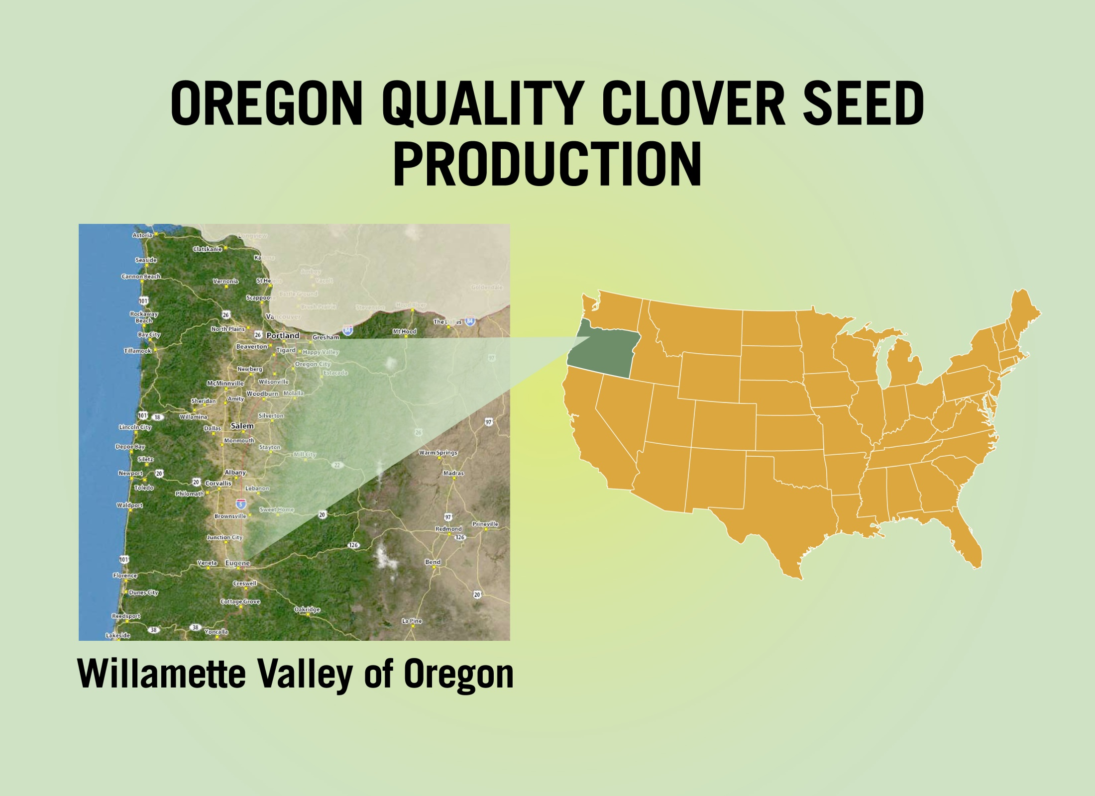
Notes:
Most quality clover seed grown in the USA is produced in the Willamette Valley of Oregon.

Slide 23
Funding For This Presentation Was Provided By:
Oregon Clover Commission
P.O. Box 2042
Salem, Oregon 97308-2042
Phone: 503-370-7019 FAX: 503-587-8063
E-mail: info@profadminserv.com
www.oregonclover.org
Developed by: Dr. Garry Lacefield, University of Kentucky
Dr. Don Ball, Auburn University
John McCulley, Oregon Clover Commission

